Slide 1
Lesson 2

Slide 2
Greetings
How was your week?
How was your weekend?
What did you do this week?
What did you do today?

Slide 3
Today's Plan
Prepositions
Irregular Verbs

Slide 4
Prepositions
Let's make a list of prepositions!
On
In
Under
Above
next to
Behind
Below
At
By
What is a preposition?
A word that describes where or when something is

Slide 5
Prepositions
At
On
In
By
→ Transportation
→ Location
→ Time

Slide 6
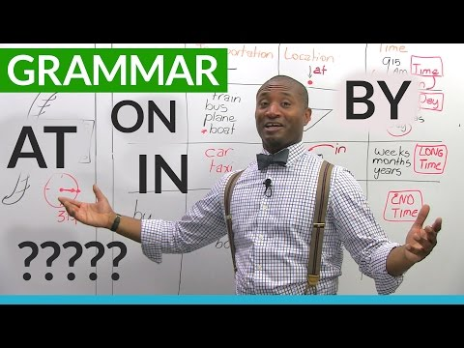
Transportation:
Please pay attention to how at, on, in, and by are used when talking about transportation!

Slide 7
Transportation:
Where are you right now?
I am ______ a plane.
I am ______ my car.
I am ______ the train.
How did you get here?
I came here ______ car.
We came here ______ train.

Slide 8
Location:
Please pay attention to how at, on, in, and by are used when talking about location!

Slide 9

Location:

Slide 10
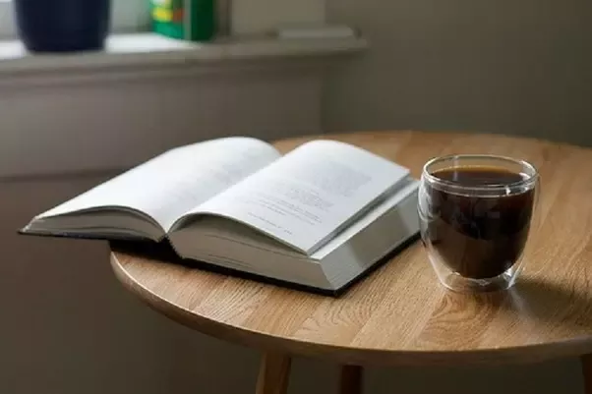
Location:

Slide 11
Time:
Please pay attention to how at, on, in, and by are used when talking about
time!

Slide 12
Time:
I can meet you ______ 5:00pm..
I can meet you ______ noon ______ the train station.
I will see you ______ Monday.
I need to leave here ______ 8:00pm.
I left my house ______ Friday and came here ______ plane.

Slide 13
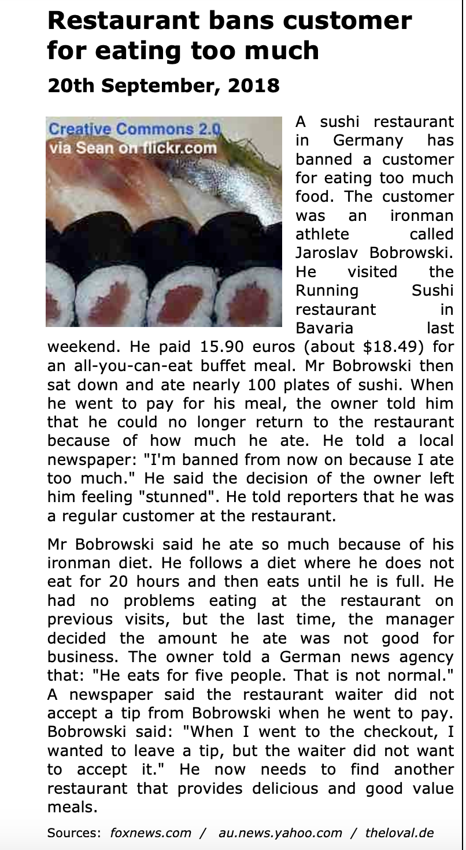
Were there any words you did not know?
Let's try to find the prepositions!

Slide 14
Irregular Verbs
An irregular verb is one where the past tense does not seem to follow a sort of rule in comparison to the present tense.
Can you think of any irregular verbs? Let's make a list!
Notes:
Did not get to this

Slide 15
Irregular Verbs
Present → Past
I am/he is/we are → I was/he was/we were
I am a worker. → I was a student.
I am reading the book. → I was watching TV.
I write → I wrote
I write in my notebook. → I wrote a letter.
I draw → I drew
I draw a flower. → I drew a house.
Past tense words: yesterday, last week, (anything that describes a day that is before today)
Notes:
Did not get to this

Slide 16
I do → I did
I do exercise. → I did (had) a barbecue.
I make → I made
I make a cake. → Yesterday I made chicken.
I meet → I met
I meet my neighbor. → Three years ago, I met my husband!
Present tense words: today, right now…
I pay → I paid
Today I pay for my car. → Yesterday I paid my security deposit.
I send → I sent
I send mail. → I sent a letter.
Notes:
Did not get to this

Slide 17
I sleep → I slept
Today I go to sleep early. → Yesterday I slept late.
I sleep in my bed. → I slept in that bed.
I stand → I stood
I stand all day. → Yesterday I stood all day.
I stand in line at the store. → Yesterday, I stood in line at the store.
I read (sounds like reed) → I read (sounds like red)
I cut → I cut
I cut with scissors. → Yesterday I cut my hair.
I buy → I bought (sounds like bot)
I buy food today. → Last week I bought food at the store.
I see → I saw
I see you right now. → I saw my mom yesterday.
Notes:
Did not get to this

Slide 18

Notes:
Did not get to this

Slide 19
Lesson Summary:
Today, we practiced using the prepositions at, in, on, and by to describe where some objects are, and also went over some irregulars verbs.
Homework: Write 7 sentences using the irregular verbs that we went over this lesson. Try to include some prepositions if you can!
Notes:
Updated homework: long sentences using the prepositions.

